Slide 1
Final Team Project Milestone 3 Selected Machine Learning Algorithm: Convolutional Neural Network Super Classes: Vehicle 1 and Vehicle 2
Group 8: Aarathi Nadathur, Amar Ippili, Divya Puraswani, Sai Chaitanya Tolem, Sameer Rajput, Shubh Johri
CMPE257-Spring 2019

Slide 2
Dataset-CIFAR-100
The 100 classes in the CIFAR-100 are grouped into 20 super classes with 600 images in each class.
There are 500 training images and 100 testing images per class.
Each image comes with a "fine" label (the class to which it belongs) and a "coarse" label (the superclass to which it belongs).
Our goal is to perform a binary classification of images in vehicle 1 and vehicle 2 superclass pairs.
Superclass –vehicle 1
Class- bicycle, bus, motorcycle, pickup truck, train
vehicle 2
Class- rocket, tank, tractor, streetcar, lawn-mower

Slide 3
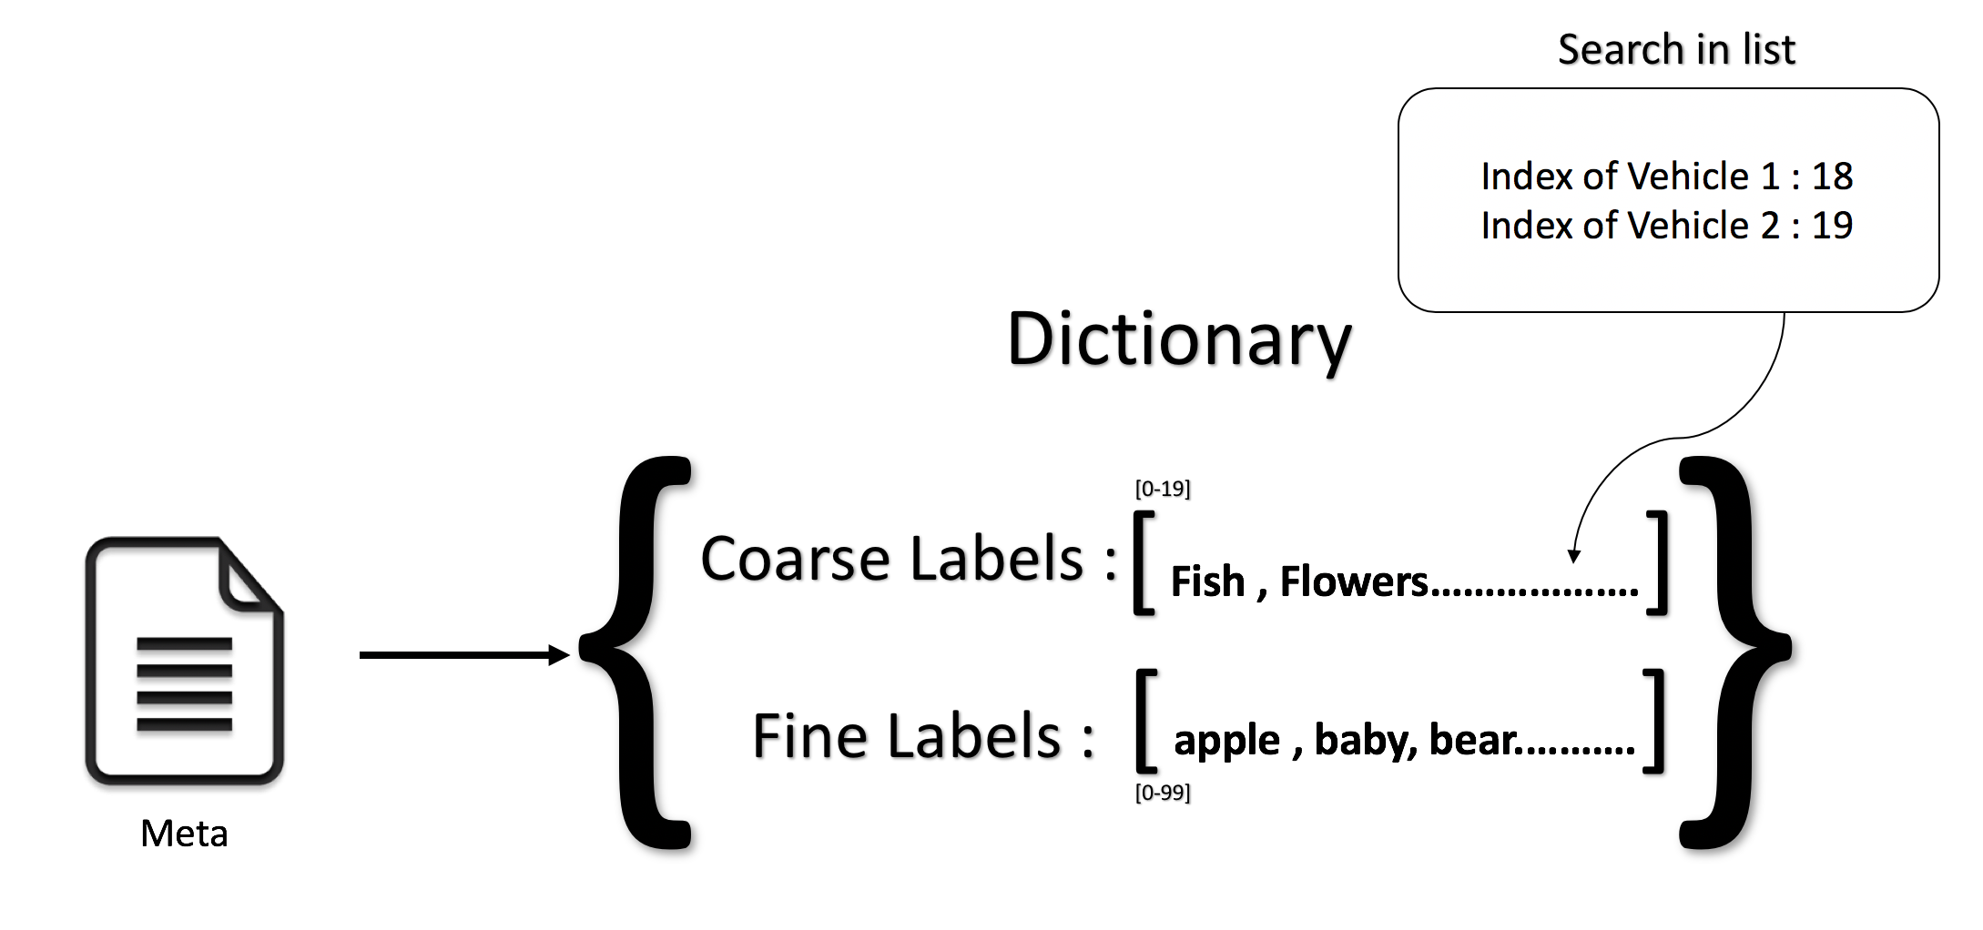
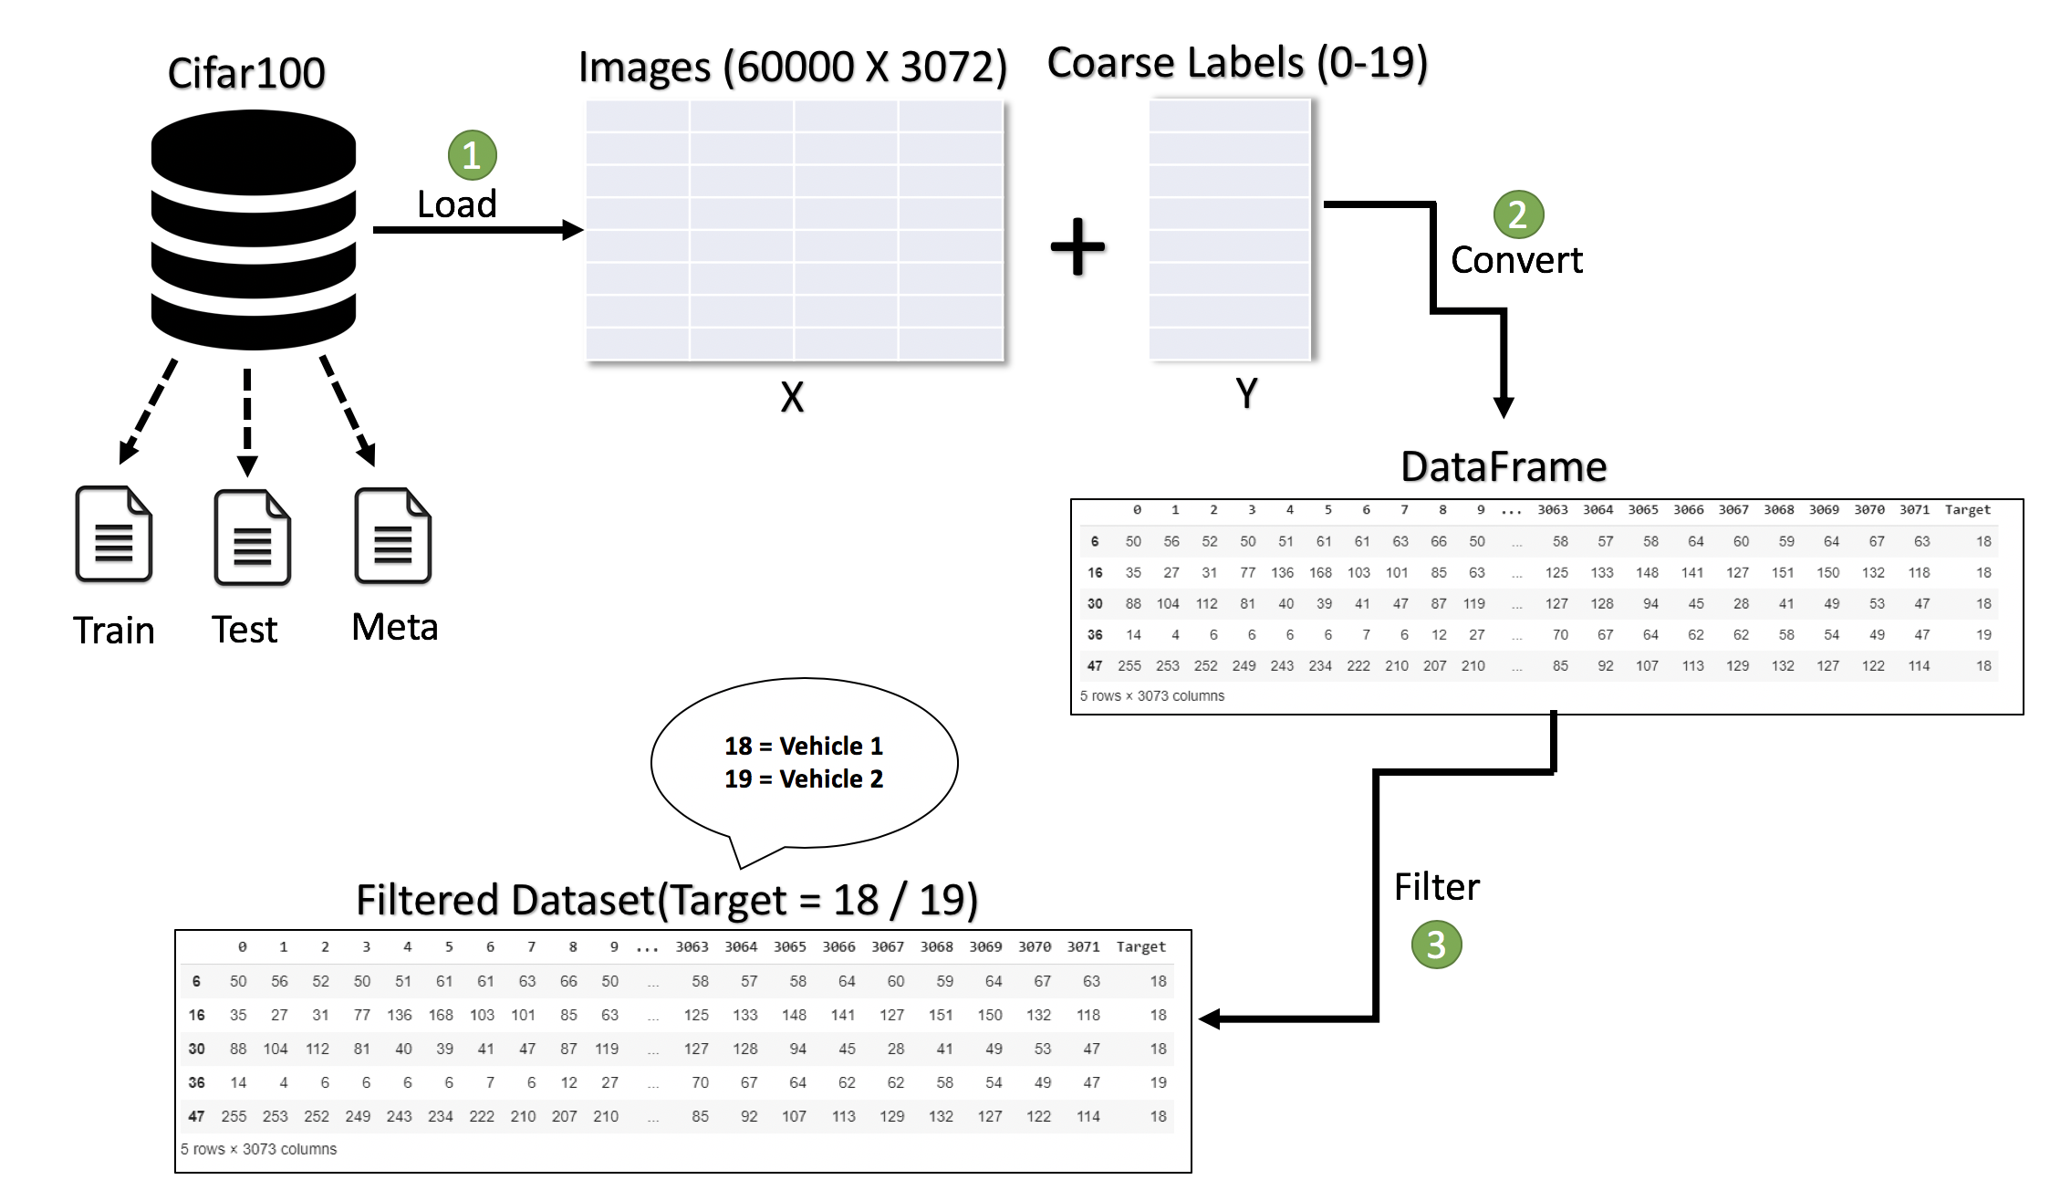
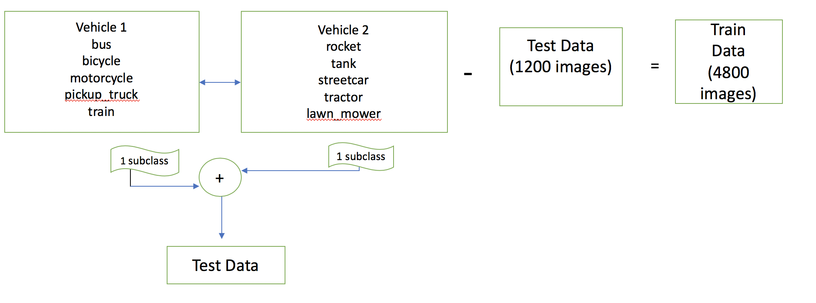
Data Preparation & Validation: Milestone 1 & Milestone 2
Milestone 1
Milestone 2

Slide 4
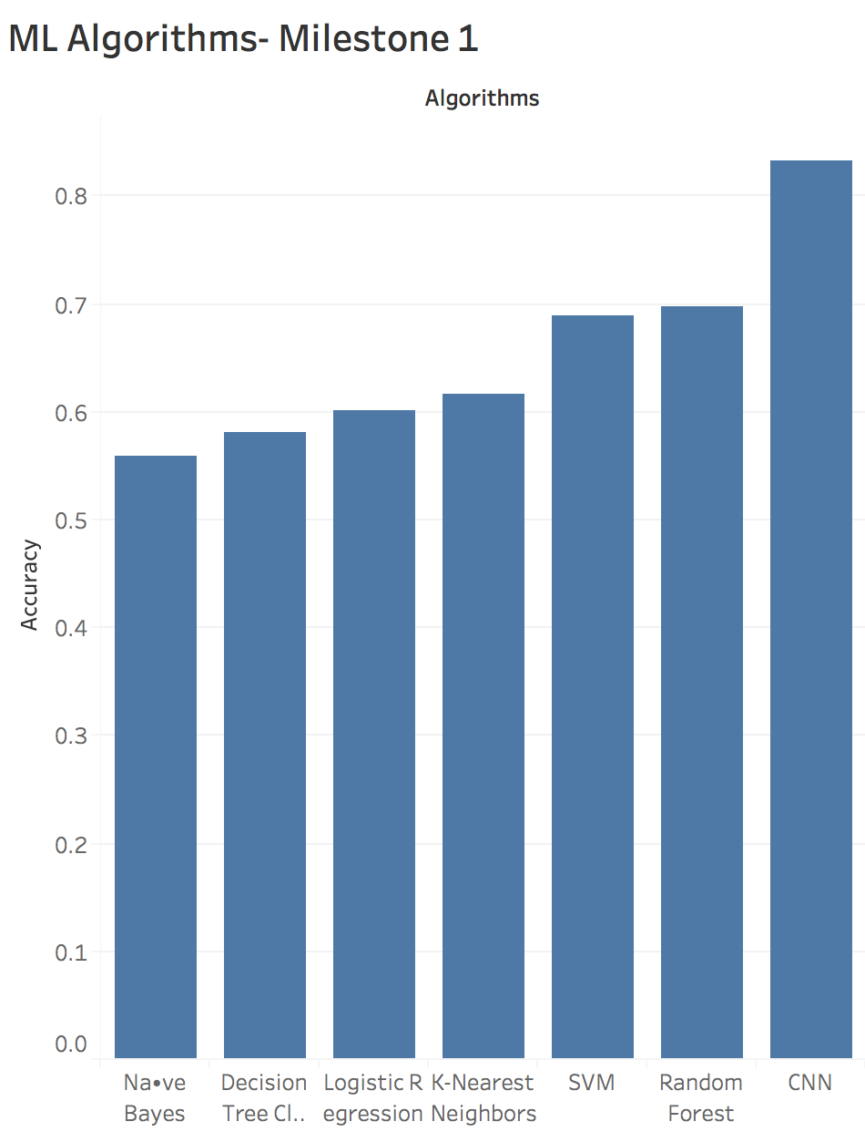
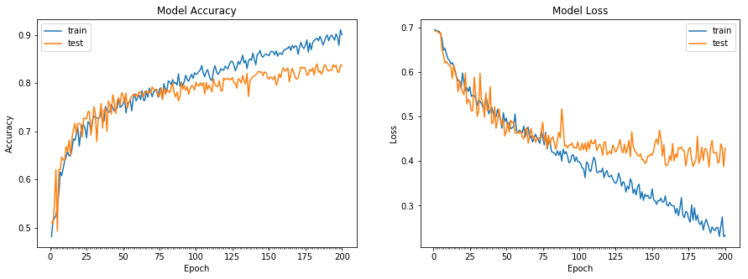
Machine Learning Algorithms Milestone 1
Best Model- CNN with 83.67%

Slide 5
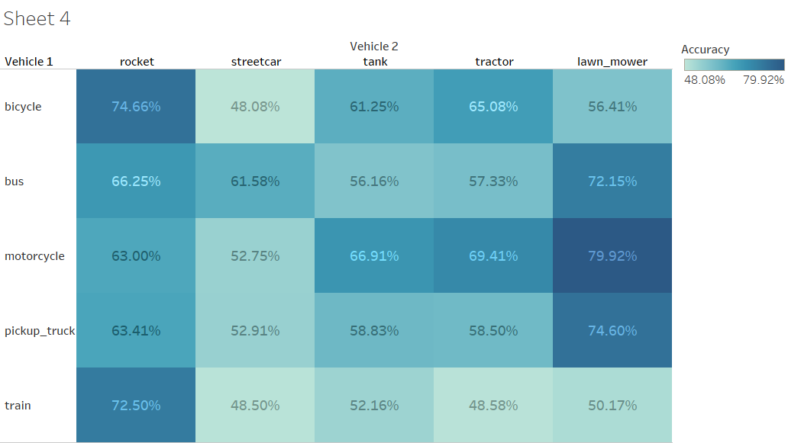
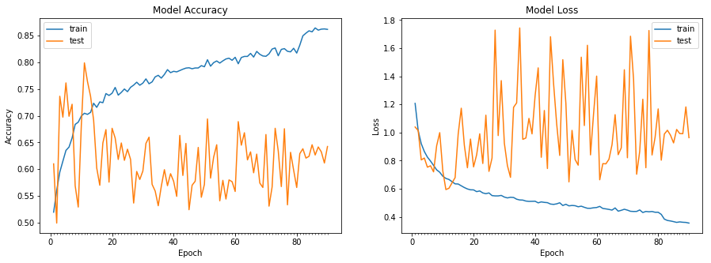
Machine Learning Algorithms Milestone 2
Best Model- Resnet(29) with 79.92%
Best Pair- motorcycle, lawn_mower

Slide 6
Selection Of Two Selected Sub- Classes from each Superclass as Testing Data.
Vehicle 1
bus
bicycle
motorcycle
pickup_truck
train
Vehicle 2
rocket
tank
streetcar
tractor
lawn_mower
Train
Data
(3600 images)
Test Data
(2400 images)
-
=
Motorcycle, Pickup Truck
2 subclass
2 subclass
Streetcar, Lawn_mower
+
Test Data

Slide 7
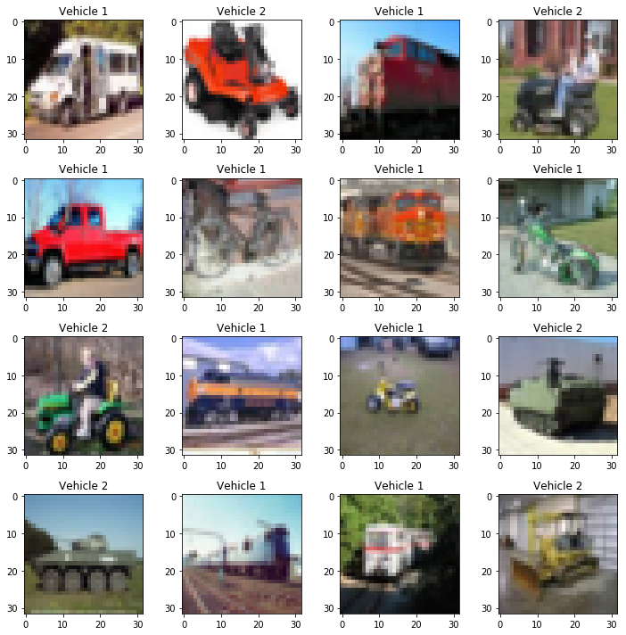
Validation of classes

Slide 8
Code Preparation
Permutations of Vehicle1/Vehicle2 – 20
Remove duplicate combinations – 10
Nested loops to run all combination pairs – 100
Code reusability with functions

Slide 9
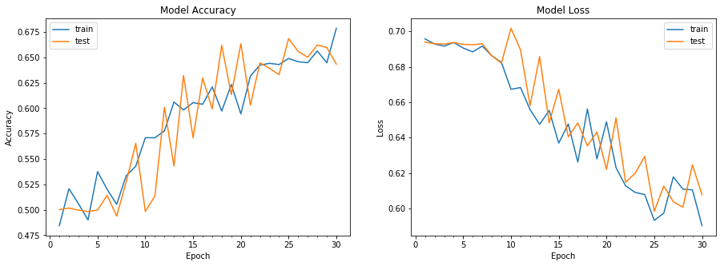
Selected Model-CNN
Best Pair(vehicle1): motorcycle, pickup truck
Best Pair(vehicle2): lawn_mower, streetcar
Number of epochs: 30
Learning rate: 0.00005
Batch size: 128
Trainable parameters: 66,76,610
Accuracy: 68.38%

Slide 10
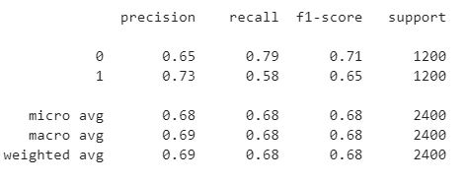
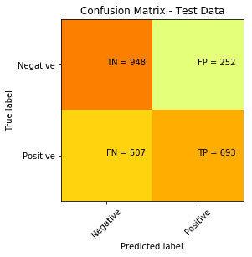
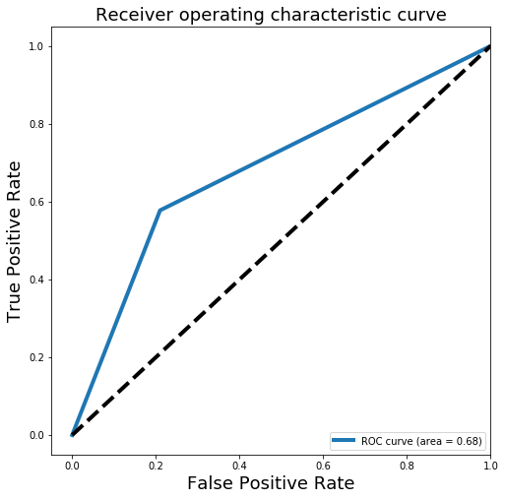
Confusion Matrix, Classification Report

Slide 11
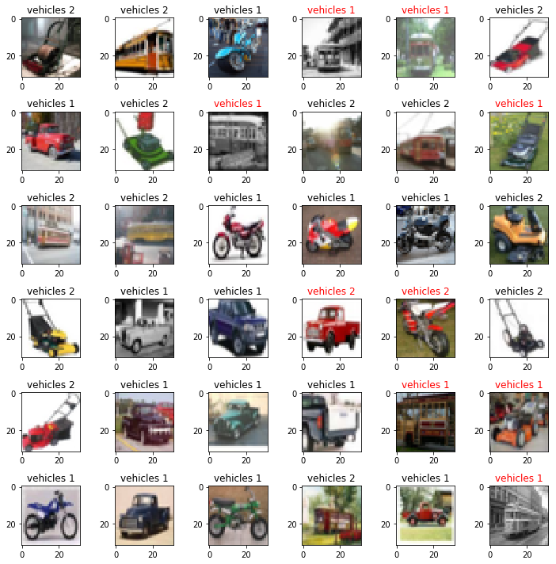
Output

Slide 12
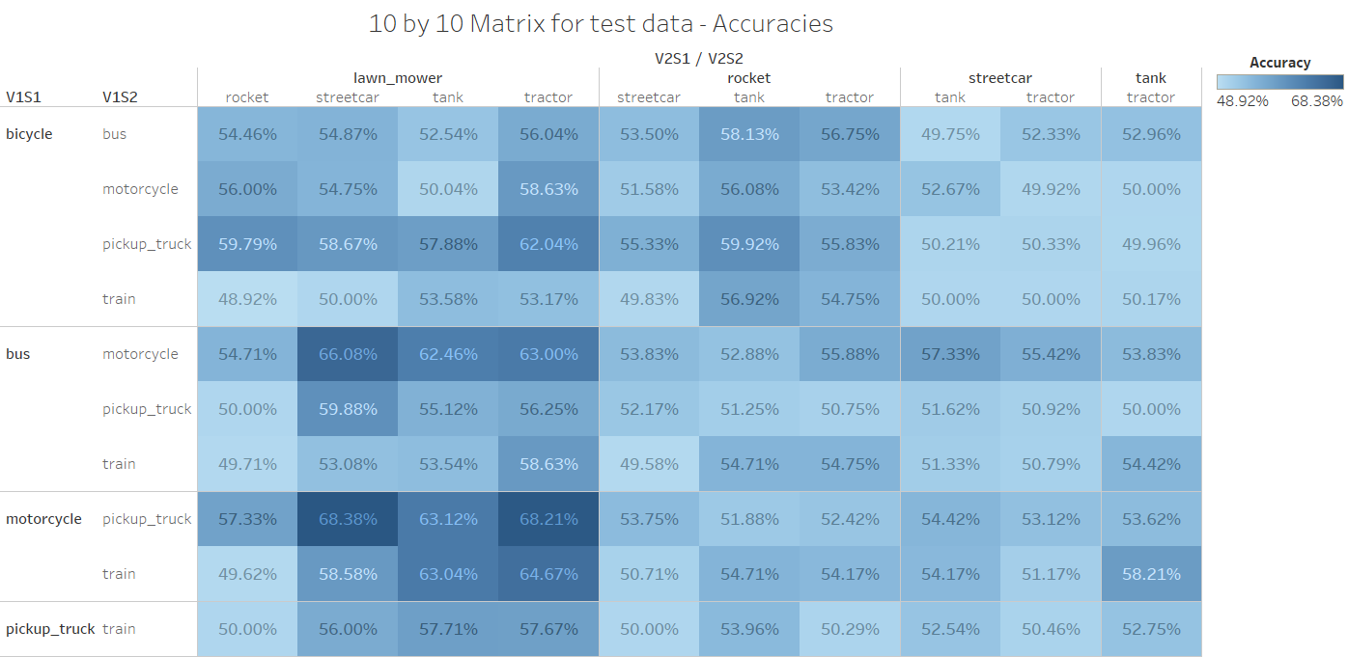
Summarization Chart (10X10)

Slide 13
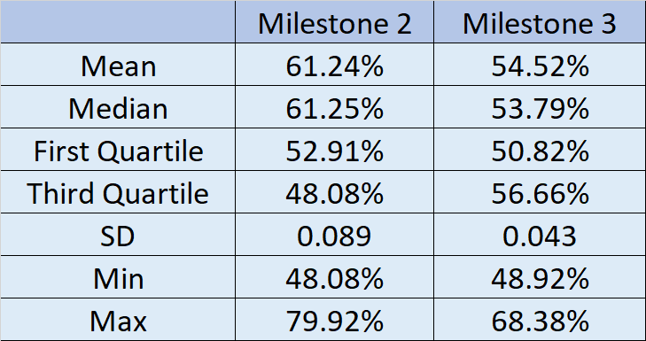
Comparison Table

Slide 14
Lessons Learned
Data Preprocessing plays an important role. - Normalization
CNN is better than all algorithms in terms of learning the features and flexibility to tune the hyperparameters
One model cannot perform well for all problem statements
Teamwork and Patience
Common pitfalls – Filtration, Looping CNN model for various combinations

